Slide 1
Other Shortcuts
Shortcut | Action
Cmd + F | Cinema Mode
Q | Trim Start at Play head
W | Split Clip
E | Trim End at Play head
Z | To Fill Zoom in Window
I | Marker In
O | Marker Out
Space Key | Play /Pause
Shift Back Space | Ripple Delete
Cmd + N | New Timeline
Cmd + I | Import Media
Cmd + Shift + . | Swap Clip Forward
Cmd + Shift + , | Swap Clip Backward
J | Play Backward
L | Play Forward
K | Pause
Shortcut | Action
Shift + L | Fast Forward
Shift + J | Fast Backward
Shift + K | Play
Shift + Tab | Active Inspecter Tab
Alt + F | Find Clip in Media Pool
P | Clip Attributes
R | Change Clip Speed
Cmd + R | Retime Control
Alt + Mouse Scroll | Zoom in Timelines
Shift + Scroll | Zoom Audio Waveform
A
T
B
M | Marker
; | Go To First Frame while Watching
. | Go To Last Frame while Watching

Slide 2
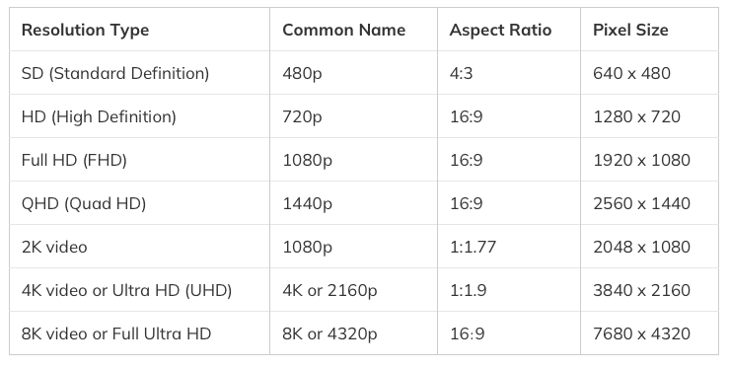

Slide 3
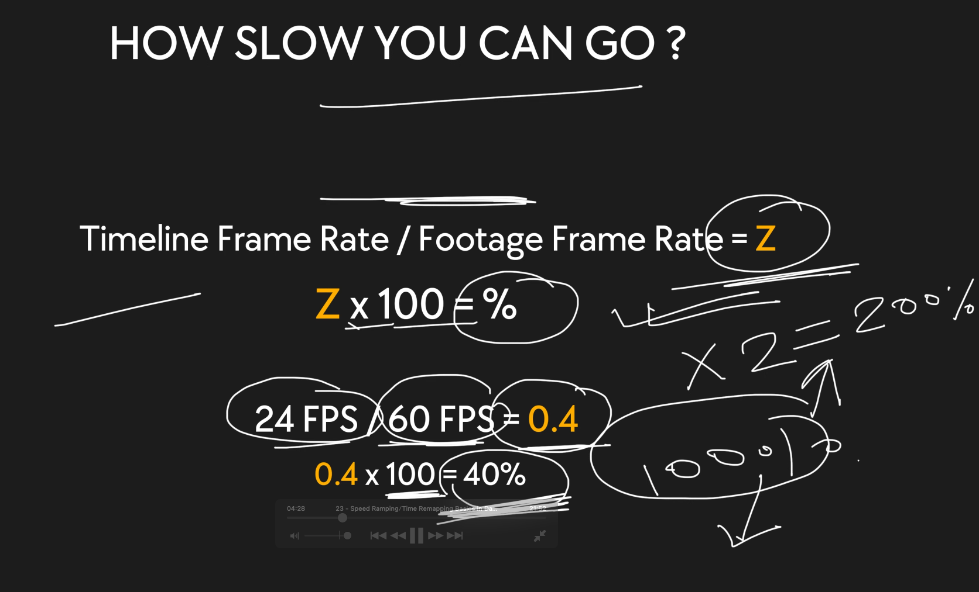

Slide 4
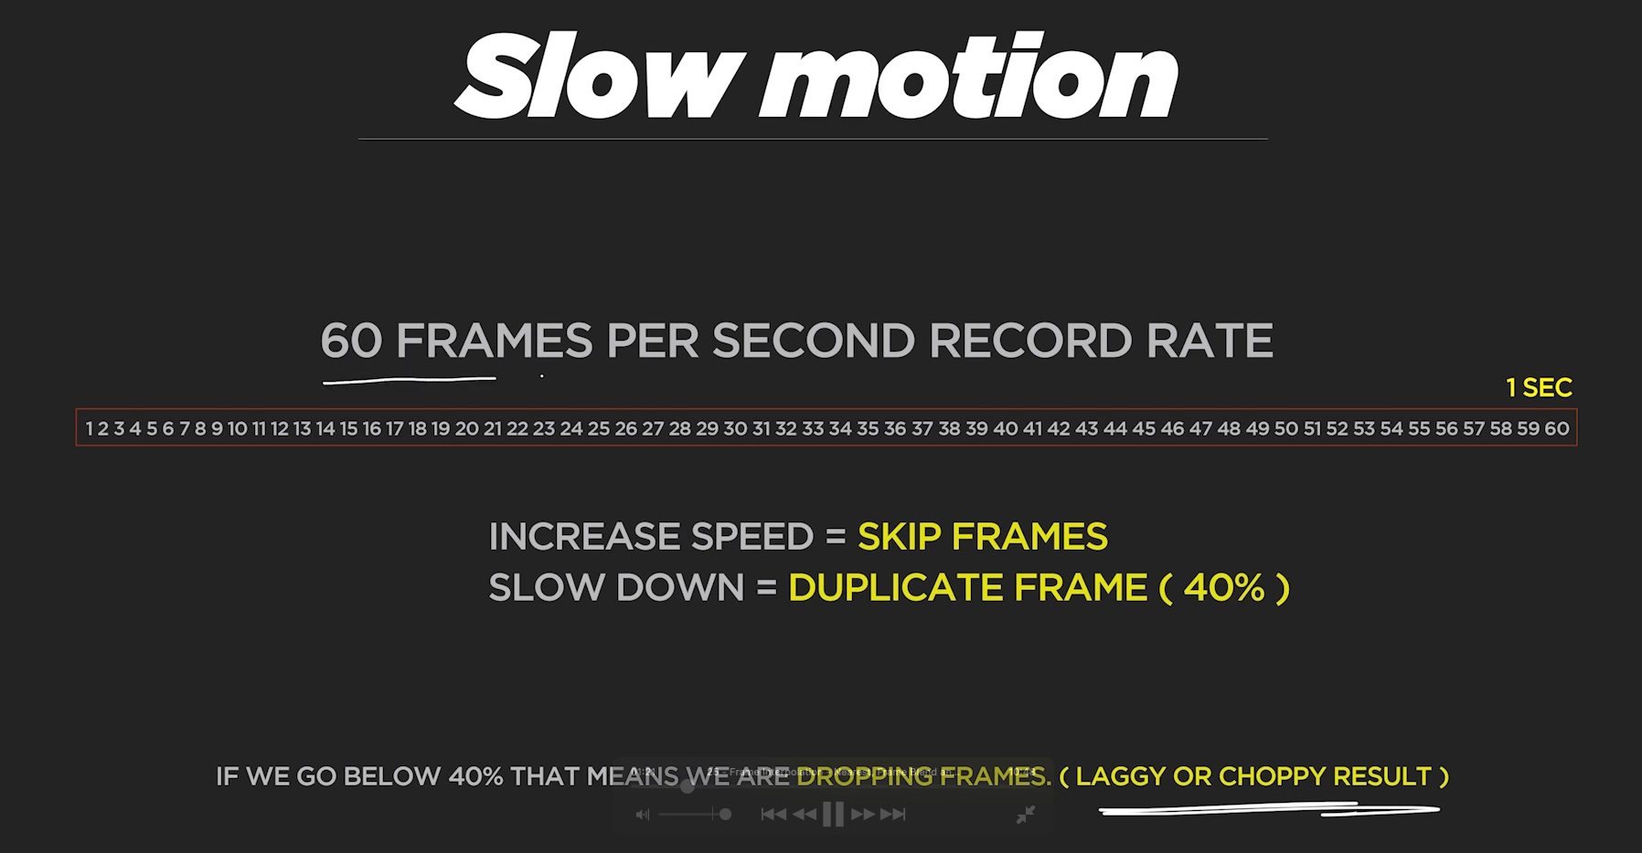

Slide 5
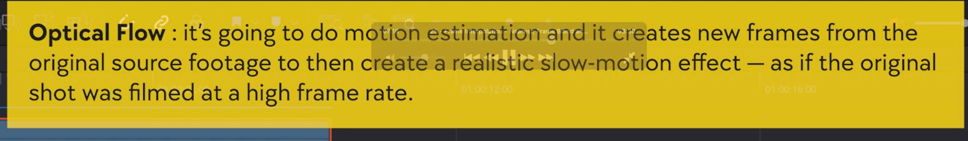
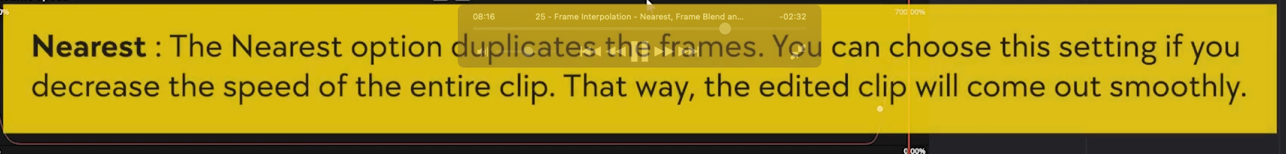
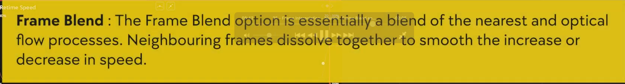

Slide 6
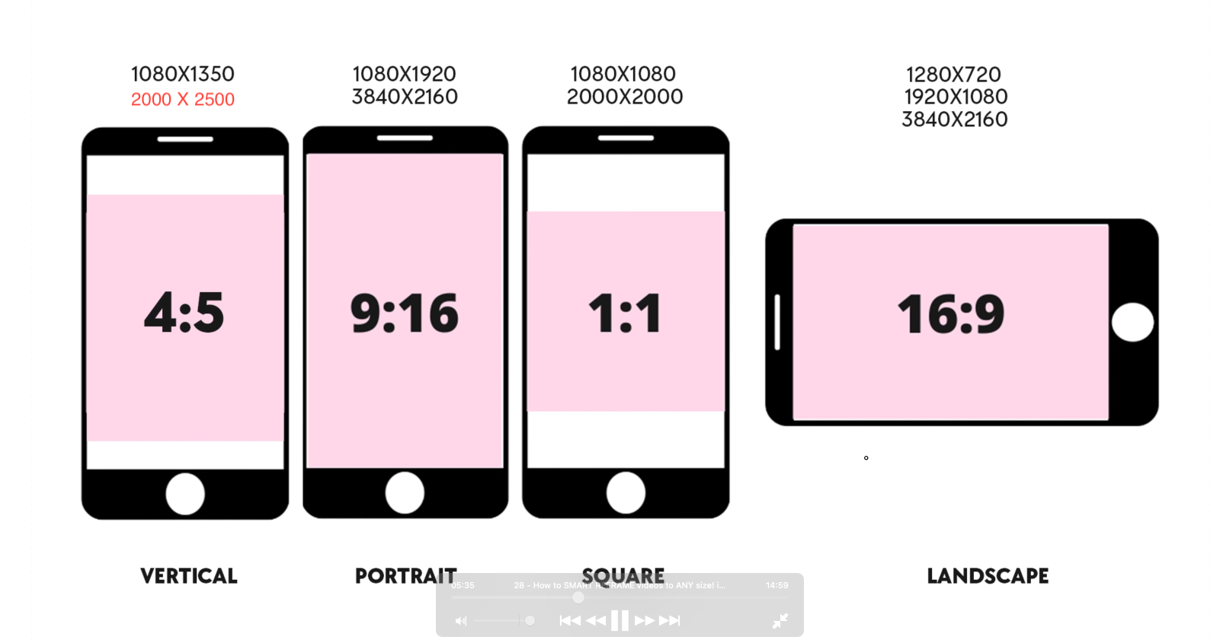

Slide 7
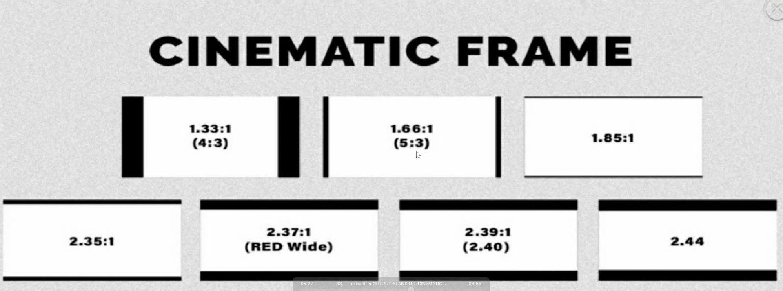

Slide 8
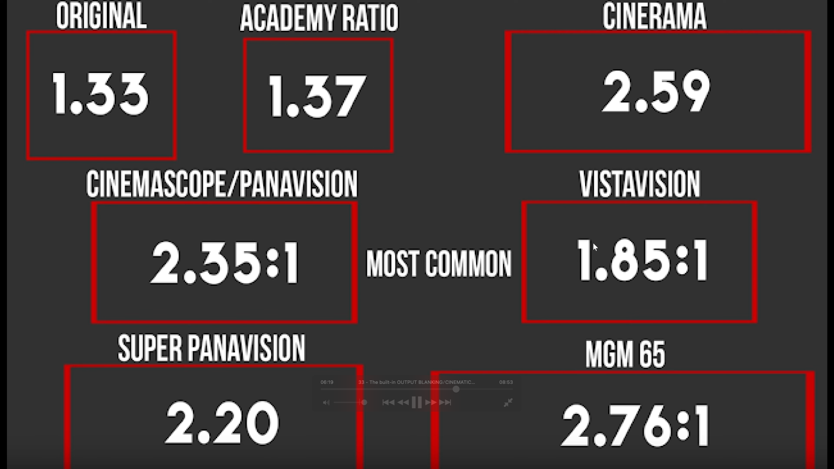

Slide 9

Fusion Tab

Slide 10
Inputs
Outputs
input
input
input
Background
Foreground
Mask Input

Slide 11
Polygon Tool
When you are in Double Poly:
Press Tab to Switch between Edge Grabbing and Edge Smoothing
Multi Merge Node
Shortcuts | Action
Hold Space & Click and Drag Node | To Release Nodes From Pipeline
Shift + Space | To Open Select Tool
Rename Nodes | F2
Ctrl + T | Swap Nodes Input (Ex. BG to FG)

Slide 12
Edit Shortcuts (Transition)
Shortcuts | Action
Shift + [ | After Entering Manual Time +03:00 Will Trim 3 Seconds
Shift + ] | After Entering Manual Time -03:00 Will Trim 3 Seconds
Opt + T | To Apply Video Default Transition
Shift + T | To Apply Audio Default Transition
Cmd + T | To Apply Audio & Video Both Default Transition

Slide 13
Shortcuts Creative Videos Tips
Shortcuts | Action
V | To Select Clip From Beginning
Cmd + L | Roll Edit (Dual rolling Trim)
Cmd + J
K | To Stop Triming

Slide 14
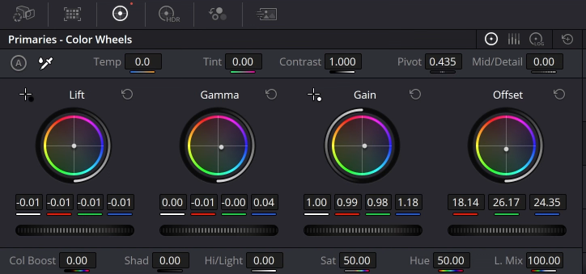
Color Tab : Color Wheel
Mid Tone
Highlights
Overall
Shadow
Brightness
Luminous Mix

Slide 15
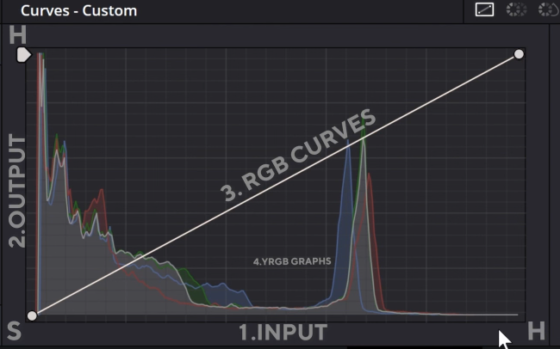
Color Tab : Custom Curve
Highlights
Mid Tone
Shadow
Mid Tone
Highlights

Slide 16


Color Tab :Power Window or Masking

Slide 17
Color Tab : Key Framing

Slide 18
Color Tab : Versions

Slide 19
Color Tab : Versions

Slide 20
Color Tab : Versions

Slide 21
Color Tab : Versions

